Slide 1

CYBER KILL CHAIN
AIMY TREESA KURIAKOSE

Slide 2
INTRODUCTION
Definition of Cyber Kill Chain: The Cyber Kill Chain is a framework used to understand and disrupt cyberattacks by breaking down the stages of a cyberattack into distinct phases.
Importance of Understanding Cyber Threats: In today's interconnected world, cyber threats are a significant concern for individuals, businesses, and governments. Understanding the Cyber Kill Chain can help organizations better defend against cyberattacks.

Slide 3
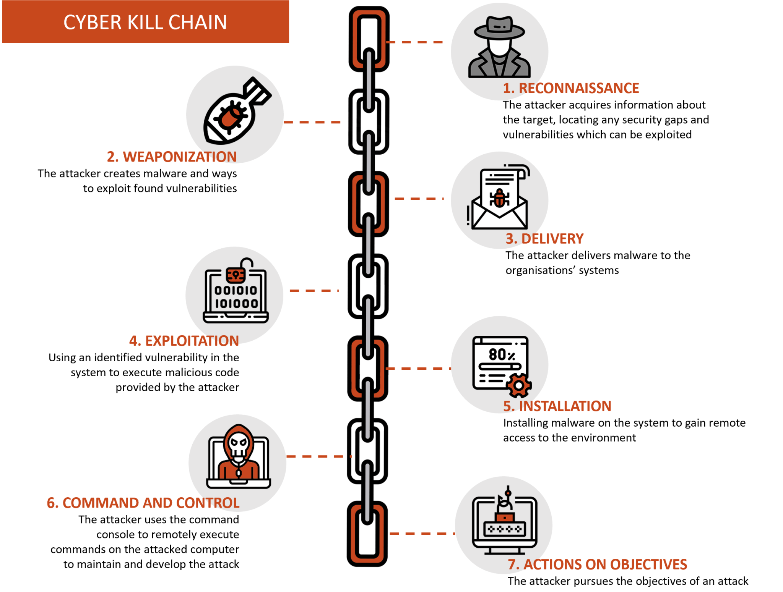
Overview

Slide 4
PHASES
Reconnaissance: Gathering information about the target.
Weaponization: Creating or obtaining malicious tools or payloads.
Delivery: Transmitting the malicious payload to the target.
Exploitation: Leveraging vulnerabilities to gain access to the target.
Installation: Installing and executing the malicious payload on the target system.
Command and Control: Establishing communication channels with the attacker's infrastructure.
Actions on Objectives: Achieving the attacker's goals, such as data theft or system disruption

Slide 5
RECONNAISSANCE
Definition and Purpose: Reconnaissance is the initial phase where attackers gather information about their target, such as network architecture, system vulnerabilities, and employee email addresses.
Common Techniques and Tools Used: Passive reconnaissance (e.g., gathering information from publicly available sources) and Active reconnaissance (e.g., network scans).
Examples of Reconnaissance Activities: Real-world examples of reconnaissance activities are social engineering attacks and network scanning.

Slide 6
WEAPONIZATION AND DELIVERY PHASES
Explanation of Weaponization: Describe how attackers package their malicious payloads, such as malware or exploit kits.
Explanation of Delivery: Discuss methods used to deliver the malicious payload to the target, such as phishing emails, drive-by downloads, or malicious websites.
Techniques and Examples for Both Phases: Examples of weaponization and delivery techniques are using weaponized documents or exploiting software vulnerabilities.

Slide 7
EXPLOITATION PHASE
Definition and Significance: Exploitation is the phase where attackers take advantage of vulnerabilities to gain unauthorized access to systems or data.
Methods of Exploitation: Common exploitation techniques are buffer overflow attacks, SQL injection, and phishing.
Real-world Examples: Provide case studies or examples of high-profile exploitation incidents, such as the Equifax data breach or the WannaCry ransomware attack.

Slide 8
INSTALLATION PHASE
Purpose and Methods of Installation: Attackers install and execute their malicious payloads on the target system, such as dropping files or creating registry entries.
Malware Deployment: Different types of malware used in the installation phase are trojans, ransomware, or backdoors.
Case Studies: Examples of malware installation incidents are the NotPetya malware outbreak or the Stuxnet worm.

Slide 9
COMMAND AND CONTROL PHASE
Explanation of Command and Control: Attackers establish communication channels with their malicious infrastructure to control compromised systems.
Communication Channels: Common communication protocols used in command and control (C&C) infrastructure are HTTP, IRC, or DNS.
Detecting C&C Activities: Techniques for detecting and mitigating command and control activities are network traffic analysis or endpoint monitoring.

Slide 10
ACTIONS ON OBJECTIVES PHASE
Final Phase of the Kill Chain: Actions on objectives phase is where attackers achieve their goals, such as stealing sensitive data, disrupting operations, or causing financial damage.
Achieving the Attacker's Goal: Different objectives that attackers may pursue, such as data exfiltration, destruction, or manipulation.
Data Exfiltration, Destruction, or Manipulation: Cyberattacks that resulted in data breaches, data destruction, or other significant impacts, such as the Sony Pictures hack or the Target data breach.

Slide 11
MITIGATION STRATEGIES
Importance of Disrupting the Kill Chain: Disrupting the Cyber Kill Chain to prevent successful cyberattacks.
Proactive Cybersecurity Measures: Proactive cybersecurity measures that organizations can take to defend against each phase of the Cyber Kill Chain are employee training, vulnerability management, and network segmentation.
Conclusion and Call to Action: Summarize the key points and encourage the audience to take proactive steps to enhance their cybersecurity posture.

Slide 12
CONCLUSION
Through understanding phases of the Cyber Kill Chain and mitigation strategies we can improve cybersecurity defenses and take proactive steps to prevent cyber attacks.

Slide 13
THANK YOU

